Slide 1


Nguyen Van Duc Long
Aug 24th 2024

Slide 2

Outline
Executive Summary
Introduction
Methodology
Results
Conclusion
Appendix

Slide 3
Executive Summary
Methodology
Data Collection
Data Analysis & Data Wrangling
EDA
Machine Learning
Insights

Slide 4
Introduction
In this capstone, I took the role of a data scientist working for a new rocket company SpaceY that would like to compete with SpaceX founded by Billionaire industrialist Allon Mask.
This project is to determine the price of each launch. It will do this by gathering information about SpaceX and create dashboards for your team. It will also determine if SpaceX will reuse the first stage. Instead of using Rocket Science to determine if the first stage will land successfully, it will train a machine learning model and use public information to predict if SpaceX will reuse the first stage.

Slide 5

Section 1

Slide 6
Methodology
Executive Summary
Data collection
Perform data analysis and data wrangling
Perform exploratory data analysis (EDA) using visualization and SQL
Perform interactive visual analytics using Folium and Plotly Dash
Perform predictive analysis using classification models

Slide 7
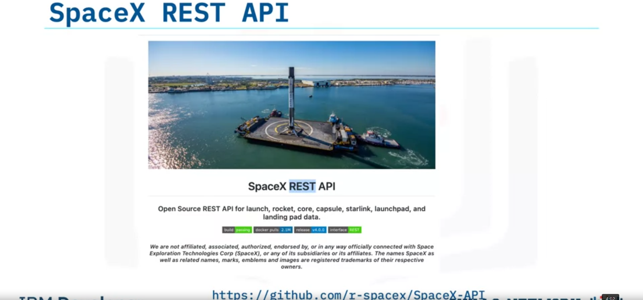
Data Collection

Slide 8
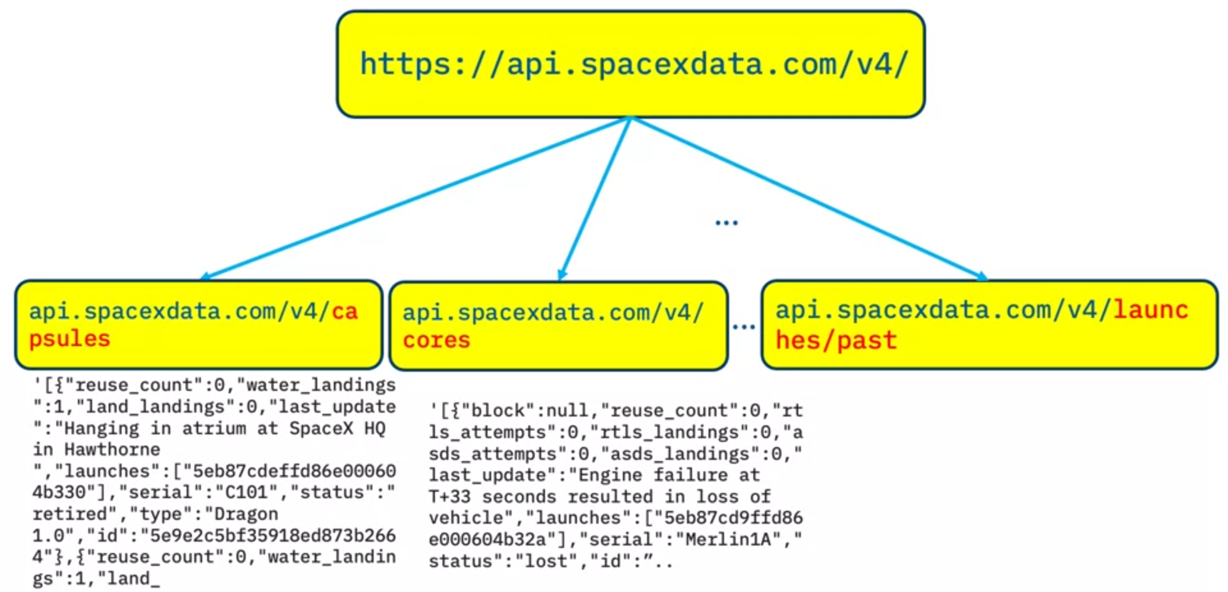
Data Collection

Slide 9

Data Collection – SpaceX API
Github URL: https://github.com/longnguyencbct/IBM-DS-Course-Repo/blob/main/Applied_Data_Science_Capstone/1_jupyter-labs-spacex-data-collection-api.ipynb

Slide 10
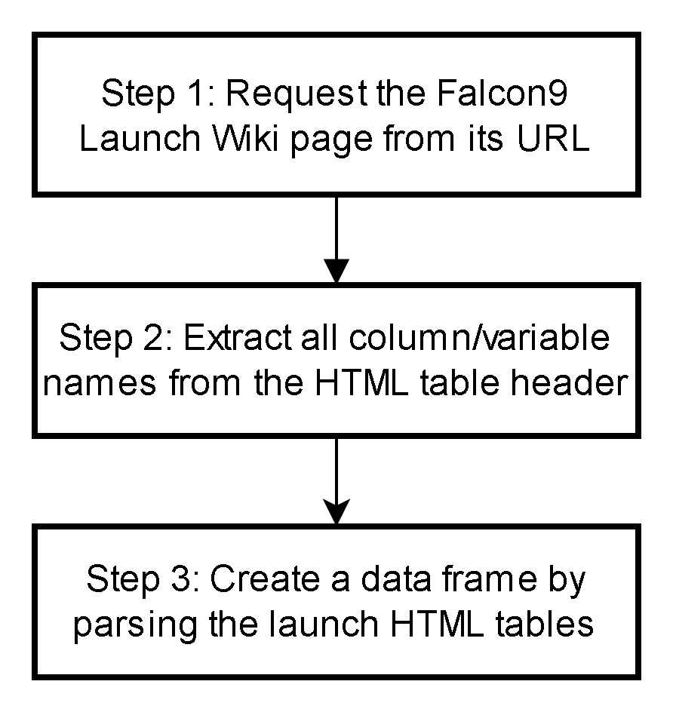
Data Collection – Scraping
Github URL: https://github.com/longnguyencbct/IBM-DS-Course-Repo/blob/main/Applied_Data_Science_Capstone/2_jupyter-labs-webscraping.ipynb

Slide 11
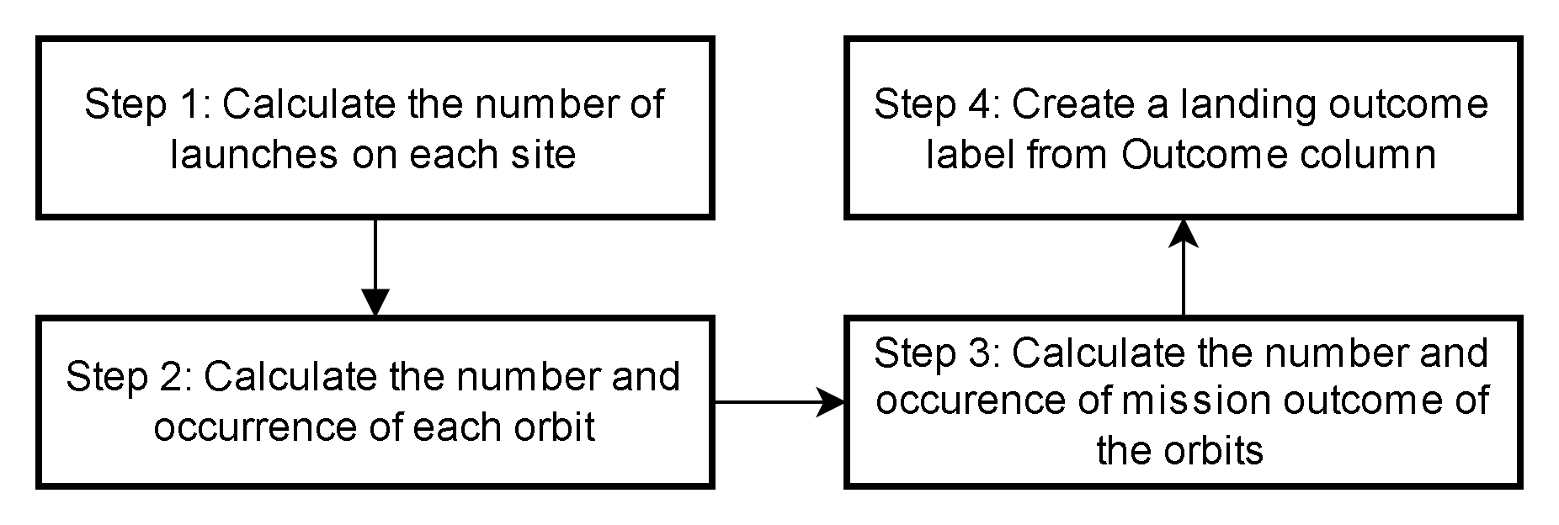
Data Analysis and Data Wrangling
Github URL: https://github.com/longnguyencbct/IBM-DS-Course-Repo/blob/main/Applied_Data_Science_Capstone/3_jupyter-spacex-Data_wrangling.ipynb

Slide 12
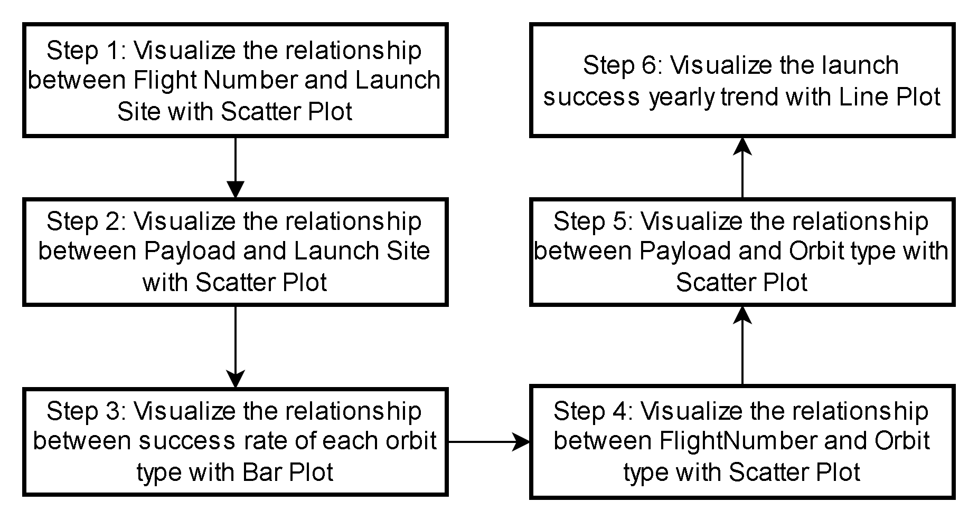
EDA with Data Visualization
Github URL: https://github.com/longnguyencbct/IBM-DS-Course-Repo/blob/main/Applied_Data_Science_Capstone/5_jupyter-labs-eda-dataviz.ipynb

Slide 13
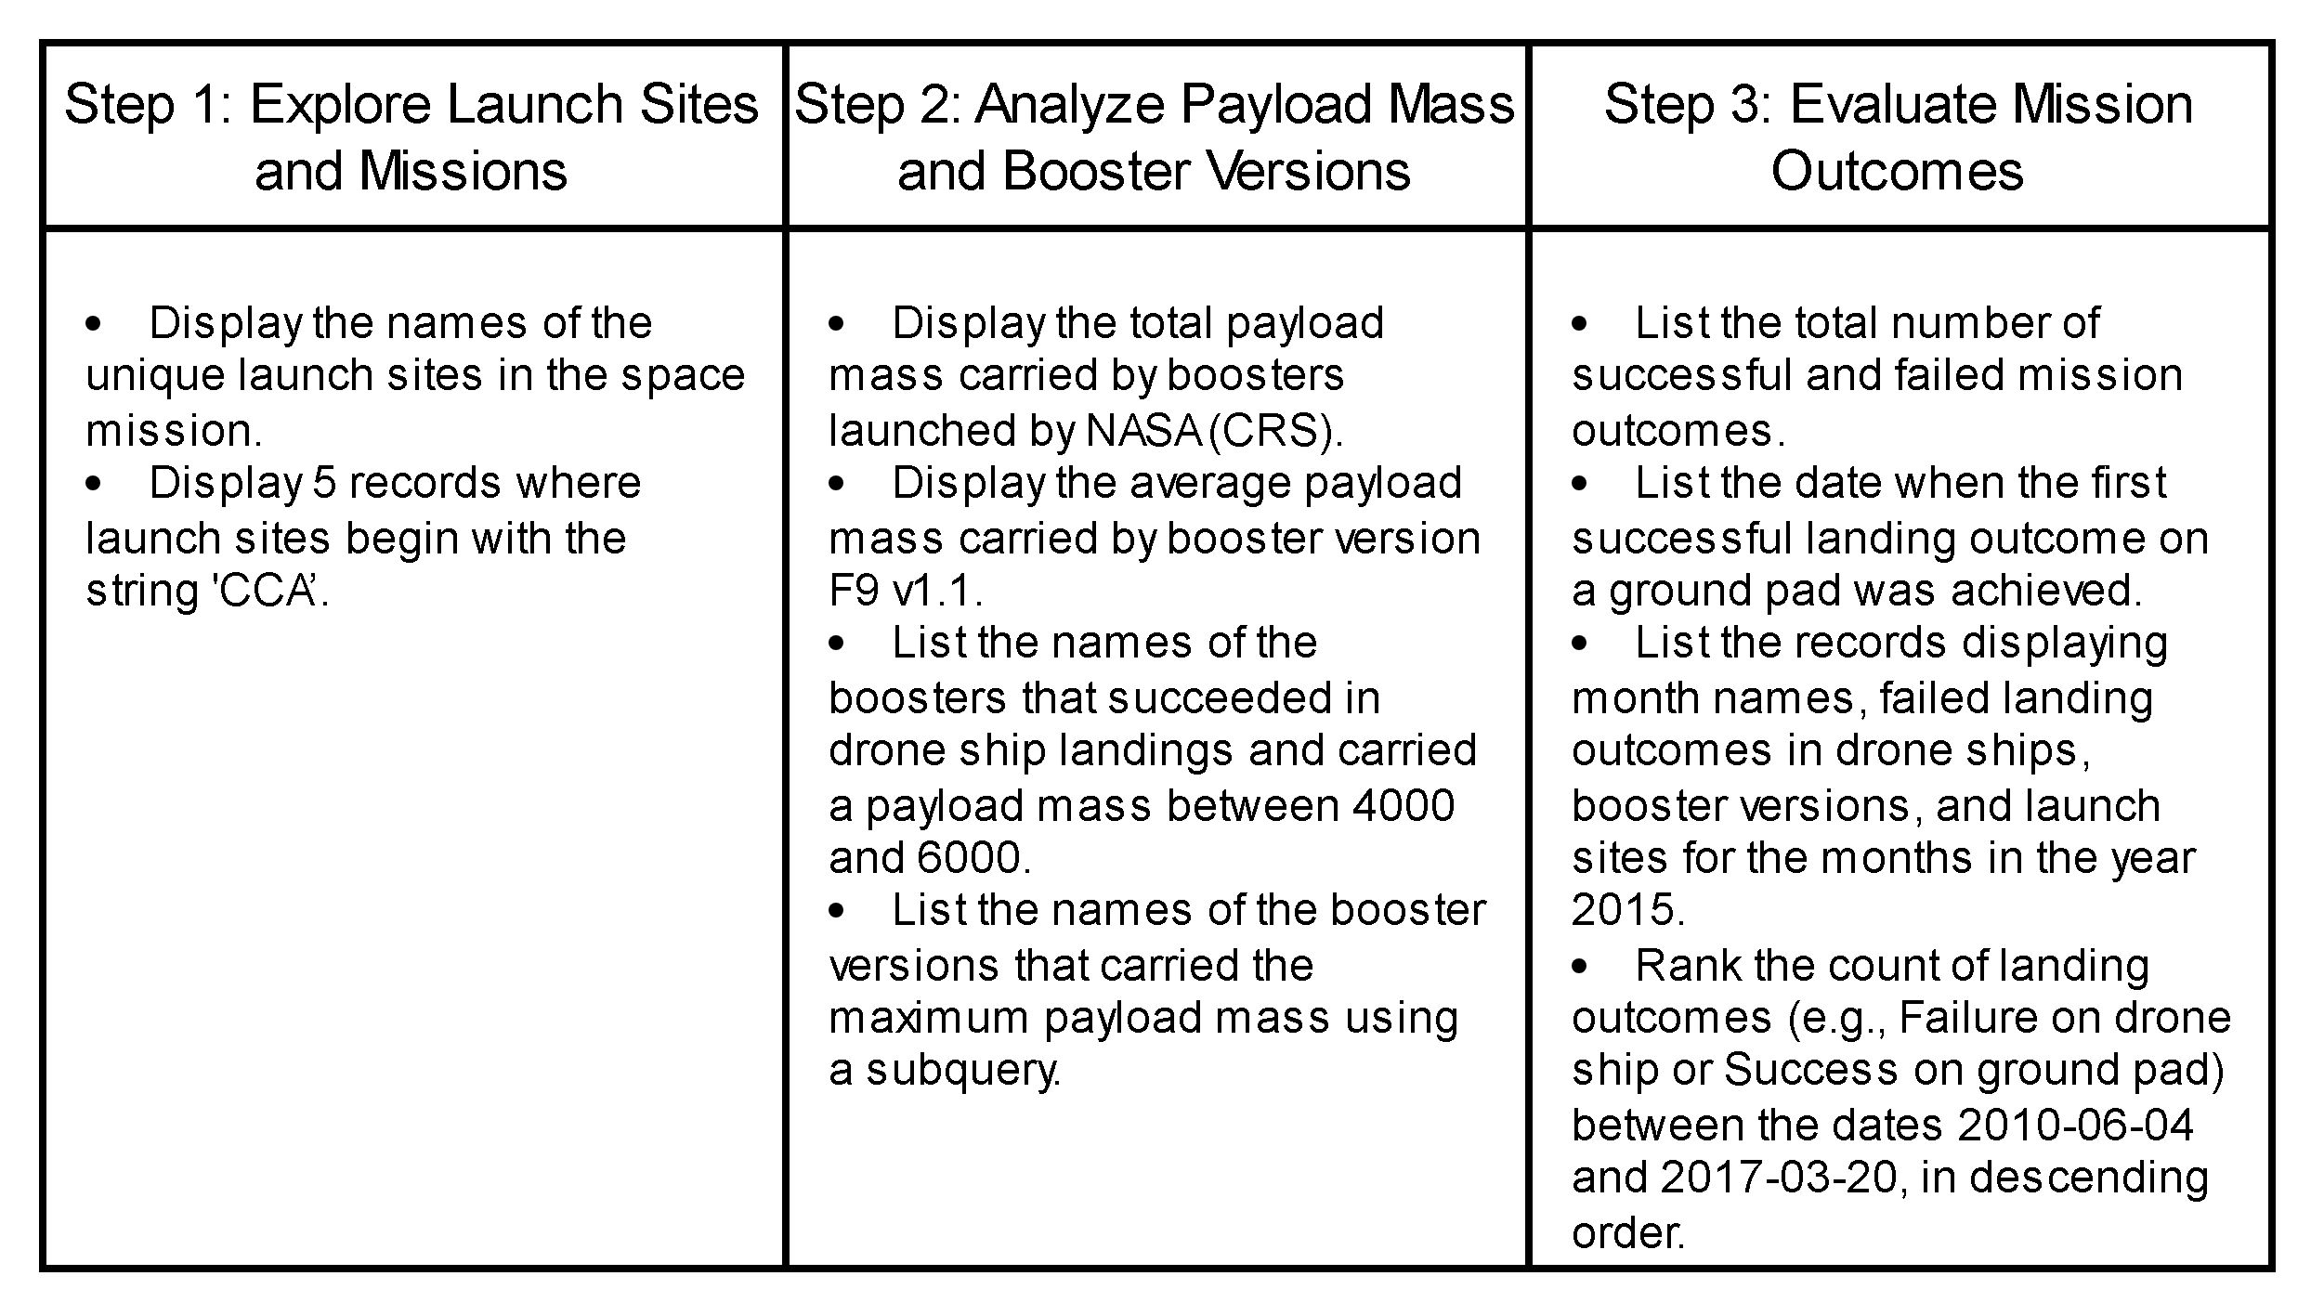
EDA with SQL
Github URL: https://github.com/longnguyencbct/IBM-DS-Course-Repo/blob/main/Applied_Data_Science_Capstone/4_jupyter-labs-eda-sql-coursera_sqllite.ipynb

Slide 14
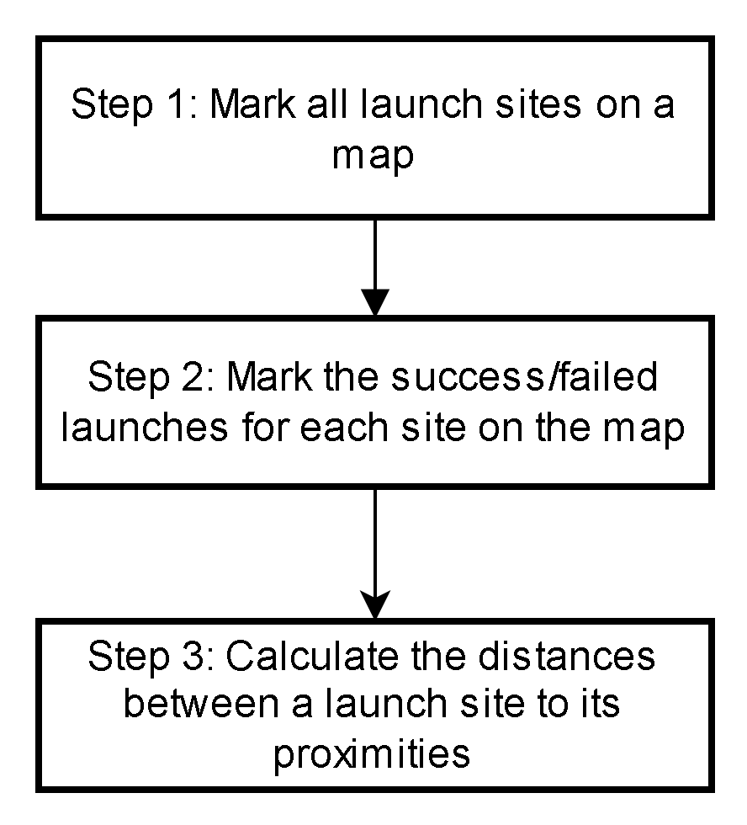
Build an Interactive Map with Folium
Github URL: https://github.com/longnguyencbct/IBM-DS-Course-Repo/blob/main/Applied_Data_Science_Capstone/6_lab_jupyter_launch_site_location.ipynb

Slide 15
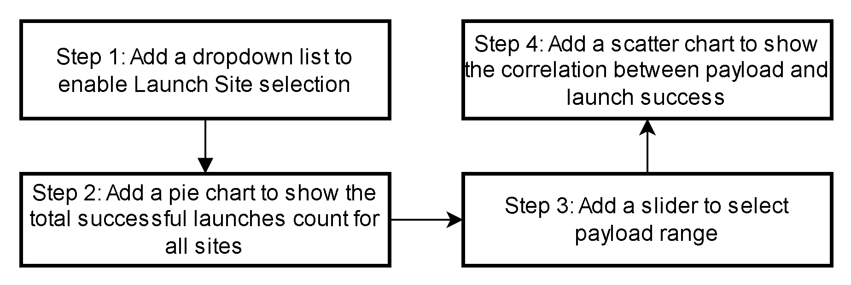
Build a Dashboard with Plotly Dash
Github URL: https://github.com/longnguyencbct/IBM-DS-Course-Repo/blob/main/Applied_Data_Science_Capstone/7_dash_interactivity.py

Slide 16
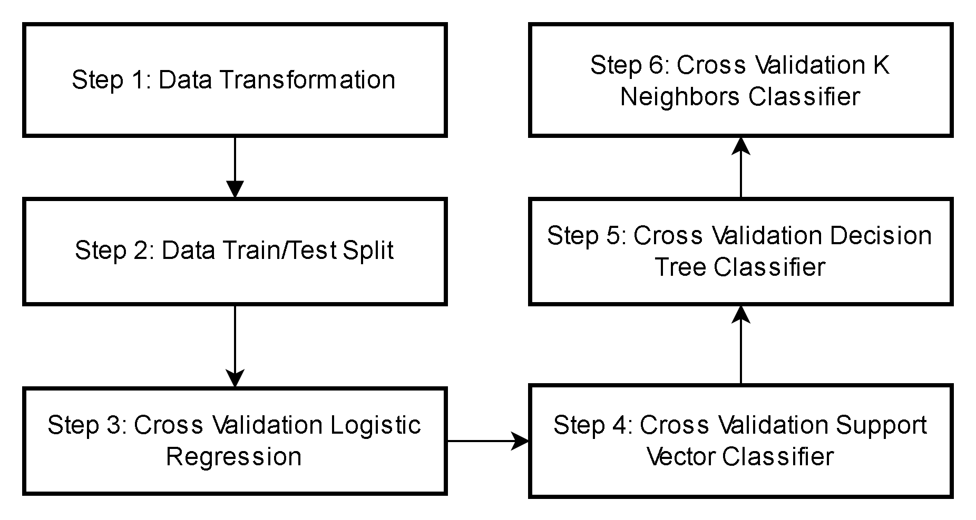
Predictive Analysis (Classification)
Github URL: https://github.com/longnguyencbct/IBM-DS-Course-Repo/blob/main/Applied_Data_Science_Capstone/8_SpaceX_Machine_Learning_Prediction.ipynb

Slide 17
Results
Exploratory data analysis results
Interactive analytics demo in screenshots
Predictive analysis results

Slide 18

Section 2

Slide 19
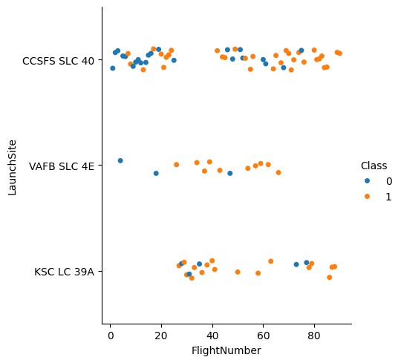
Results – EDA: Visualize the relationship between Flight Number and Launch Site
Insight: VAFB SLC 4E and KSC LC 39A Launch Sites have high success rates

Slide 20
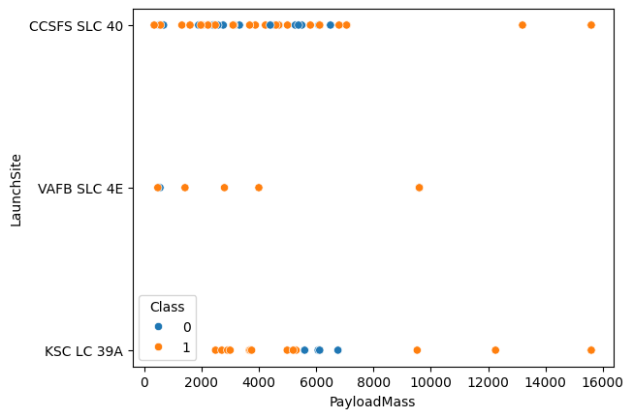
Results – EDA:
Visualize the relationship between Payload and Launch Site
Insight: Very high success rate when Payload Mass is between [2000,5000]. Payload Mass above 8000 also has high success rate, but low statistical significance.

Slide 21
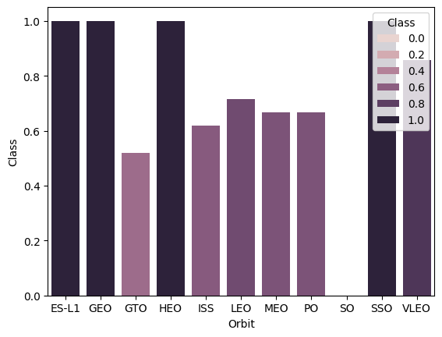
Results – EDA:
Visualize the relationship between success rate of each orbit type
Insight: ES-L1, GEO, HEO, SSO, VLEO Orbits has high success rate. But this has not considered statistical significance.

Slide 22
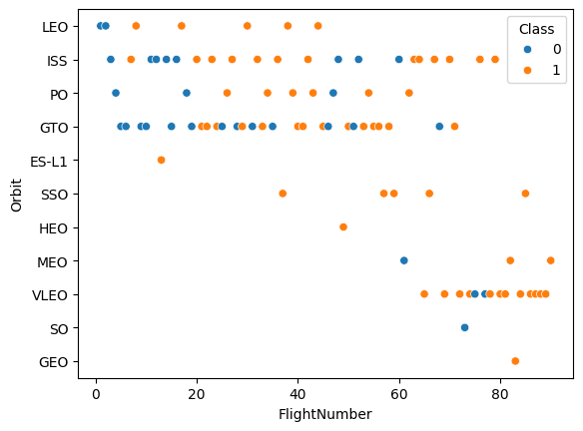
Results – EDA:
Visualize the relationship between Flight Number and Orbit type
Insight: LEO Orbit option has improved success rate over time.

Slide 23
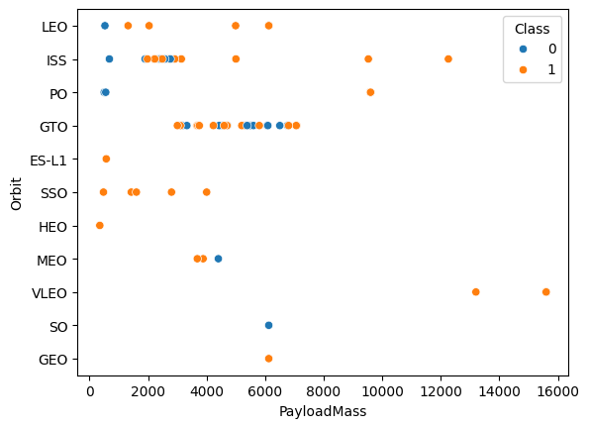
Results – EDA:
Visualize the relationship between Payload and Orbit type
Insight: With heavy payloads the successful landing or positive landing rate are more for PO, LEO and ISS. However, for GTO we cannot distinguish this well as both positive landing rate and negative landing (unsuccessful mission) are both there here.

Slide 24
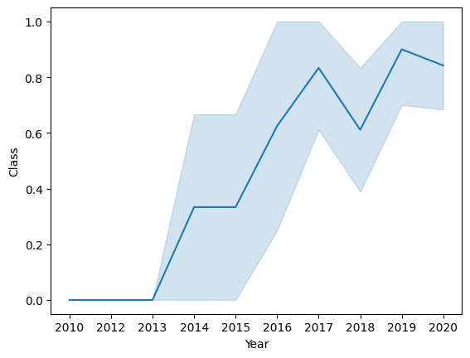
Results – EDA:
Visualize the launch success yearly trend
Insight: The success rate since 2013 kept increasing till 2017 (stable in 2014) and after 2015 it started increasing.

Slide 25
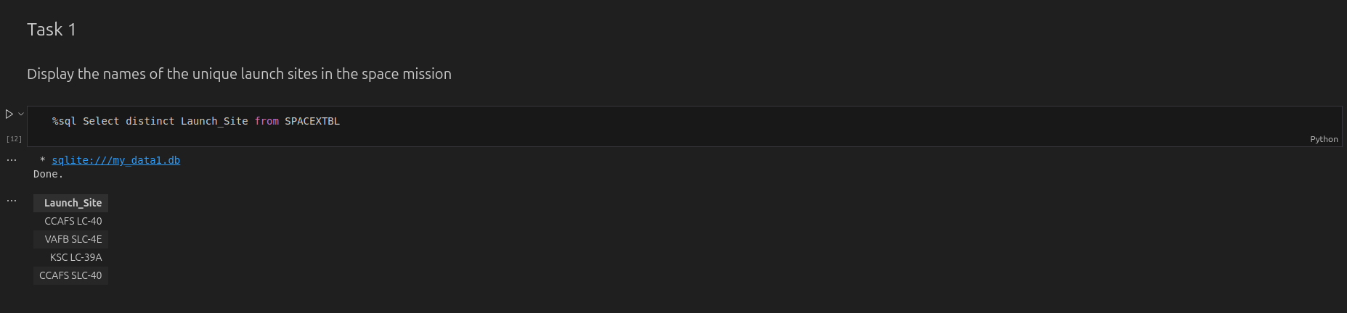
All Launch Site Names

Slide 26
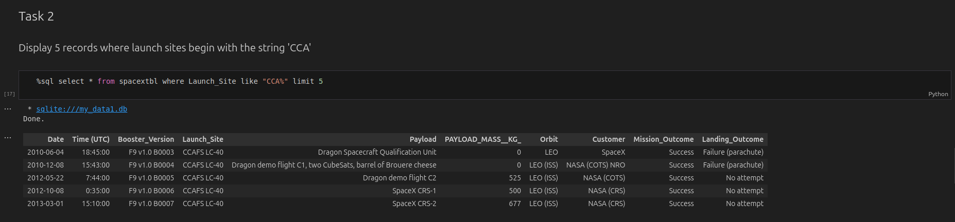
Launch Site Names Begin with 'CCA'

Slide 27
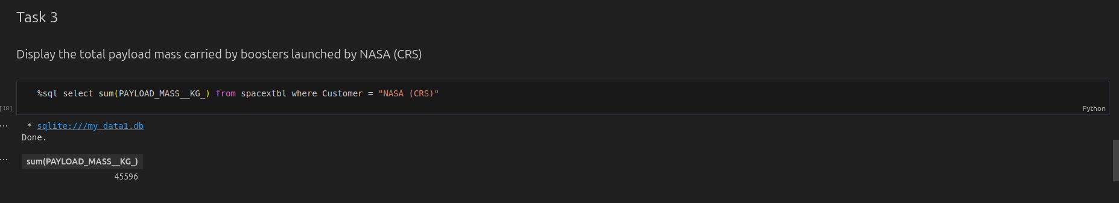
Total Payload Mass

Slide 28
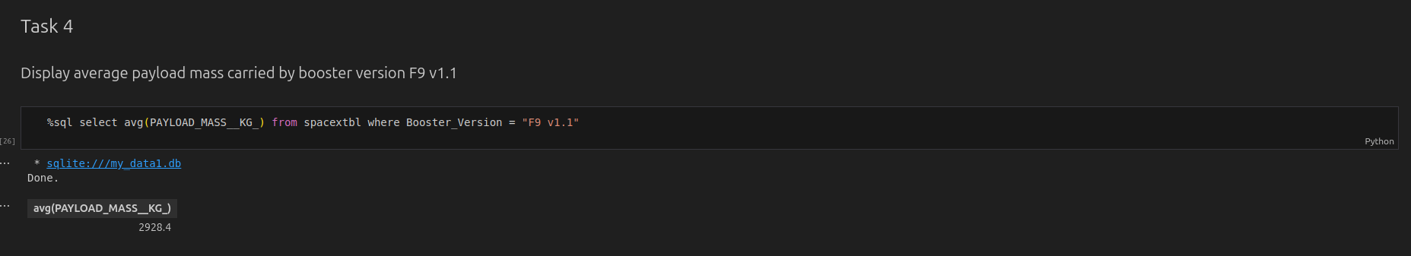
Average Payload Mass by F9 v1.1

Slide 29
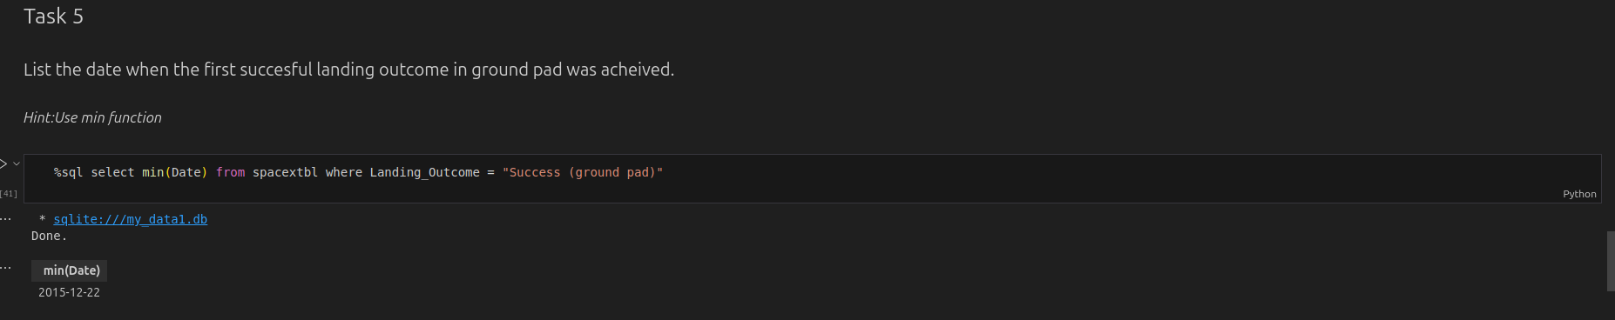
First Successful Ground Landing Date

Slide 30
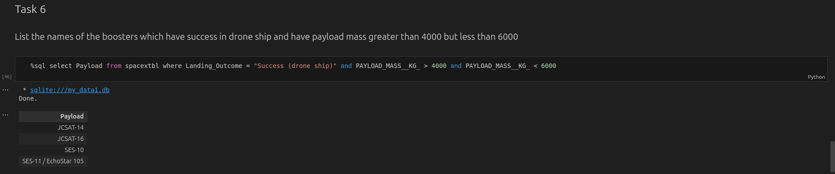
Successful Drone Ship Landing with Payload between 4000 and 6000

Slide 31
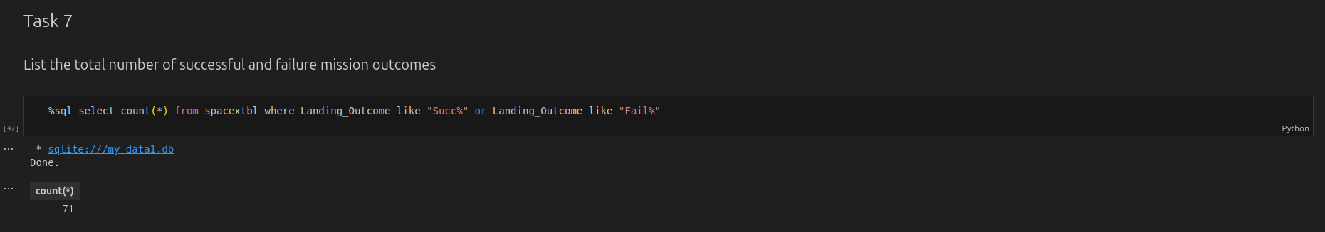
Total Number of Successful and Failure Mission Outcomes

Slide 32
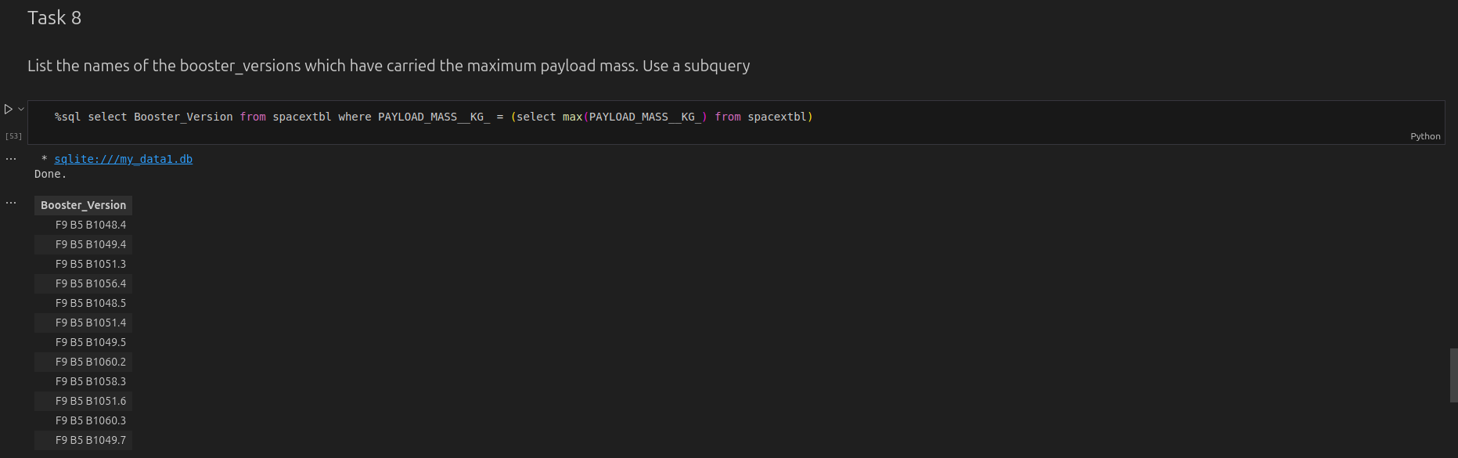
Boosters Carried Maximum Payload

Slide 33
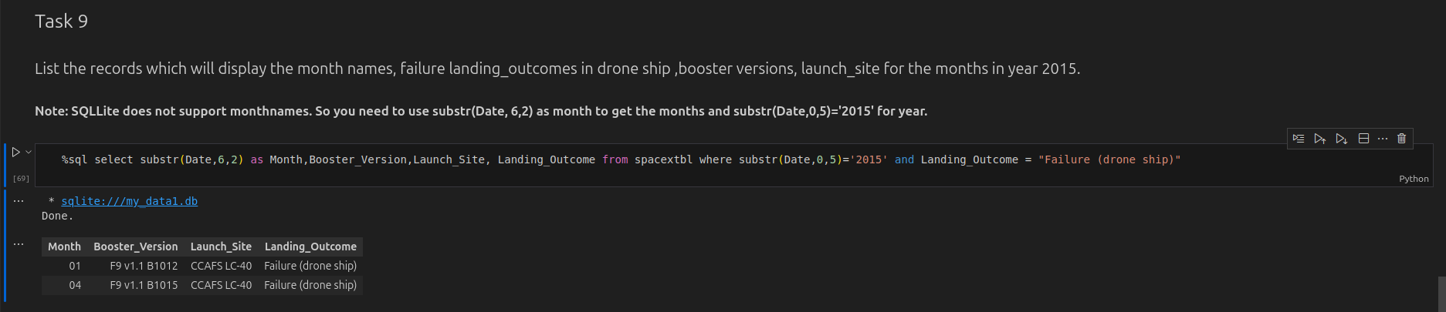
2015 Launch Records

Slide 34
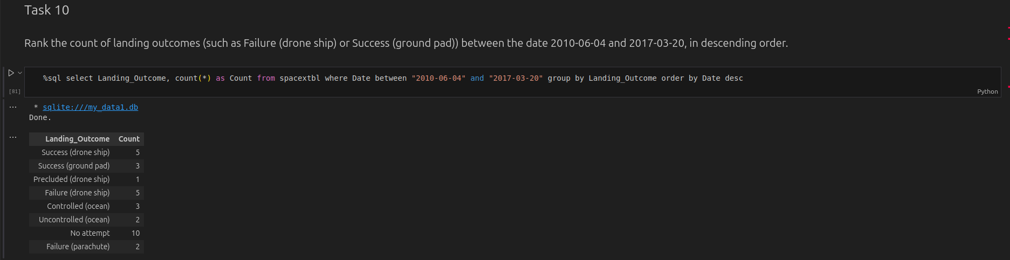
Rank Landing Outcomes Between 2010-06-04 and 2017-03-20

Slide 35

Section 3

Slide 36
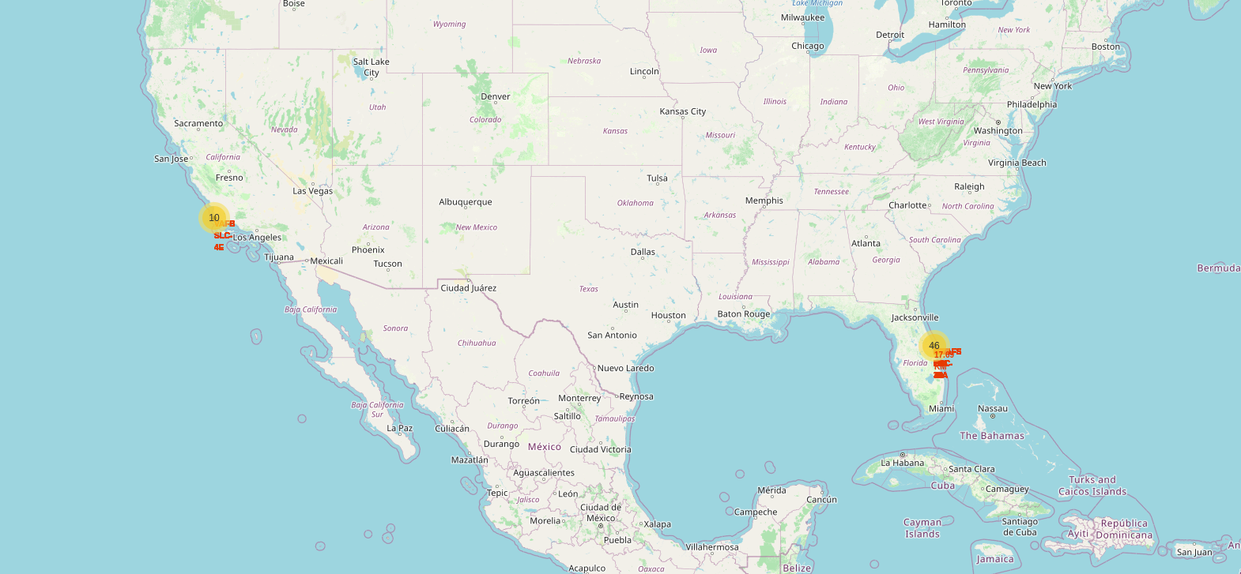
Result – Folium Map: All launch sites

Slide 37
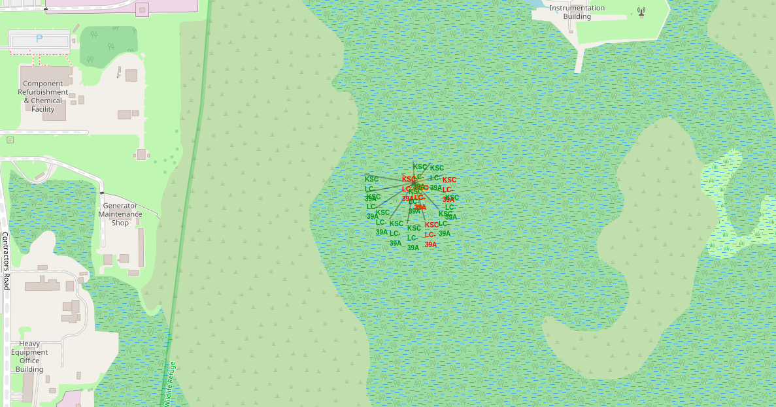
Result – Folium Map: Launch Outcomes

Slide 38
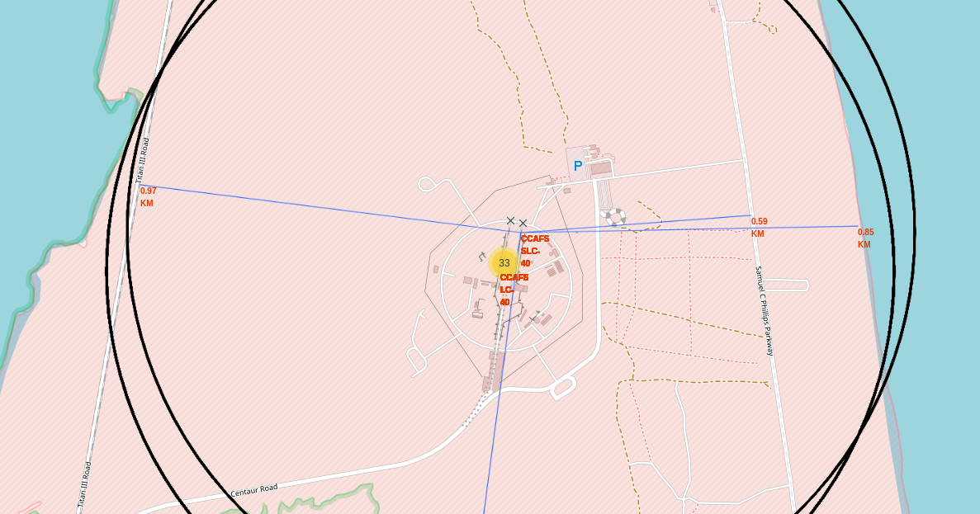
Result – Folium Map: Distance from proximities
Distance from nearest railway: 0.97KM.
Distance from nearest highway: 0.59KM.
Distance from nearest coastline: 0.85 KM.

Slide 39
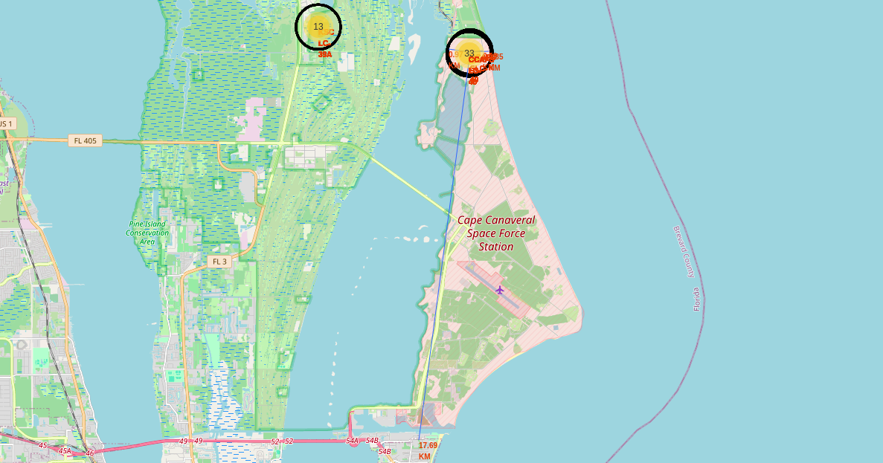
Result – Folium Map: Distance from proximities
.Distance from nearest city: 17.69 KM.

Slide 40

Section 4

Slide 41
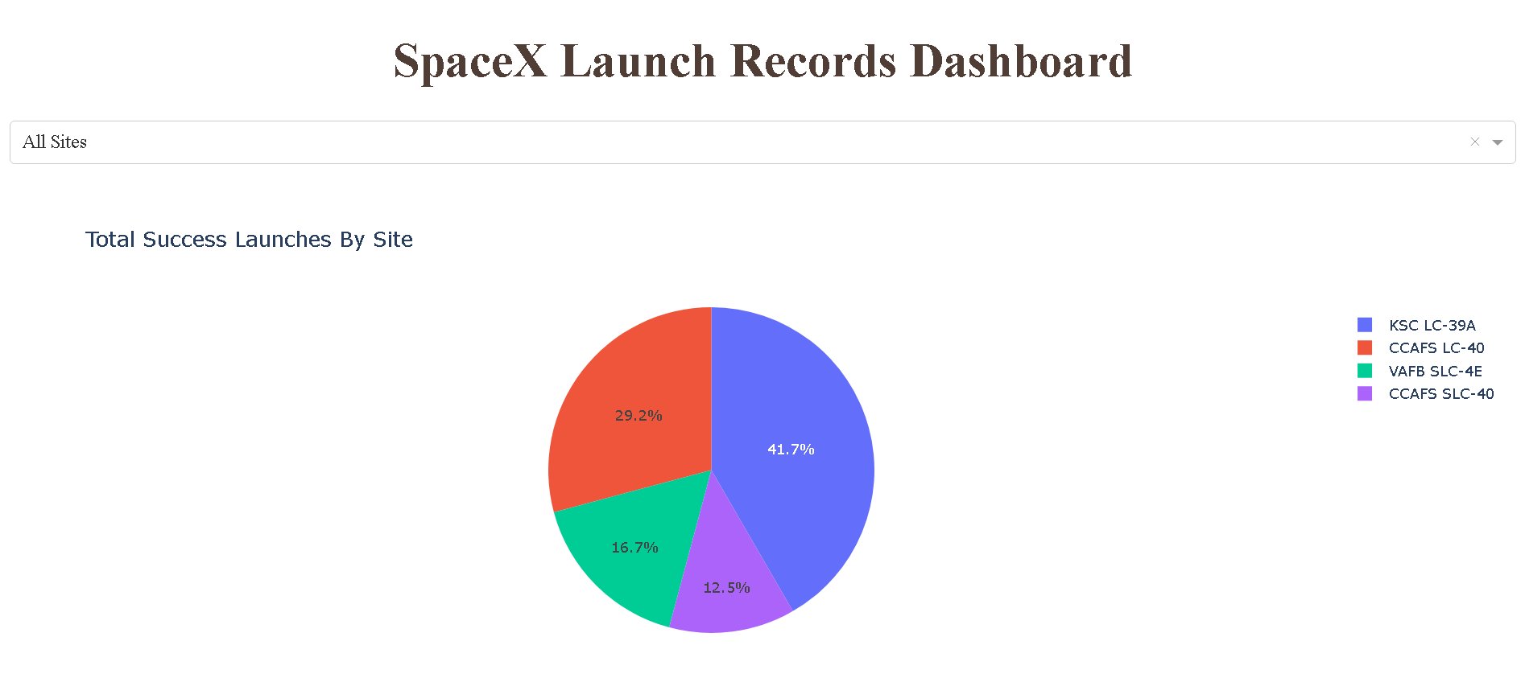
Results – Interactive: Pie Chart

Slide 42
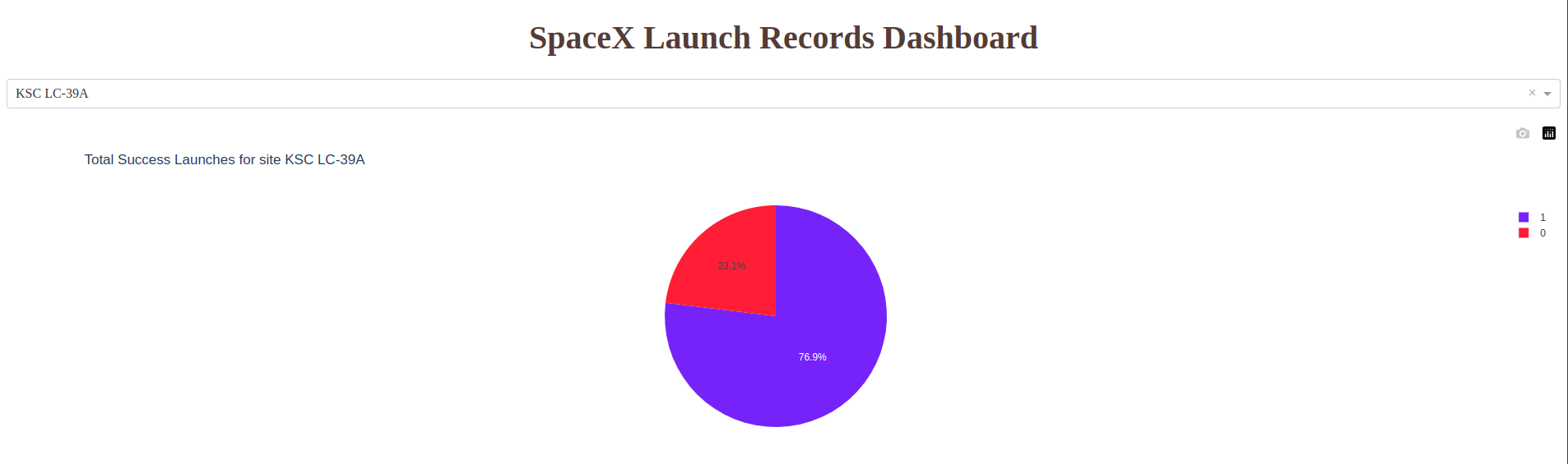
Results – Interactive: Highest success rate site pie chart

Slide 43
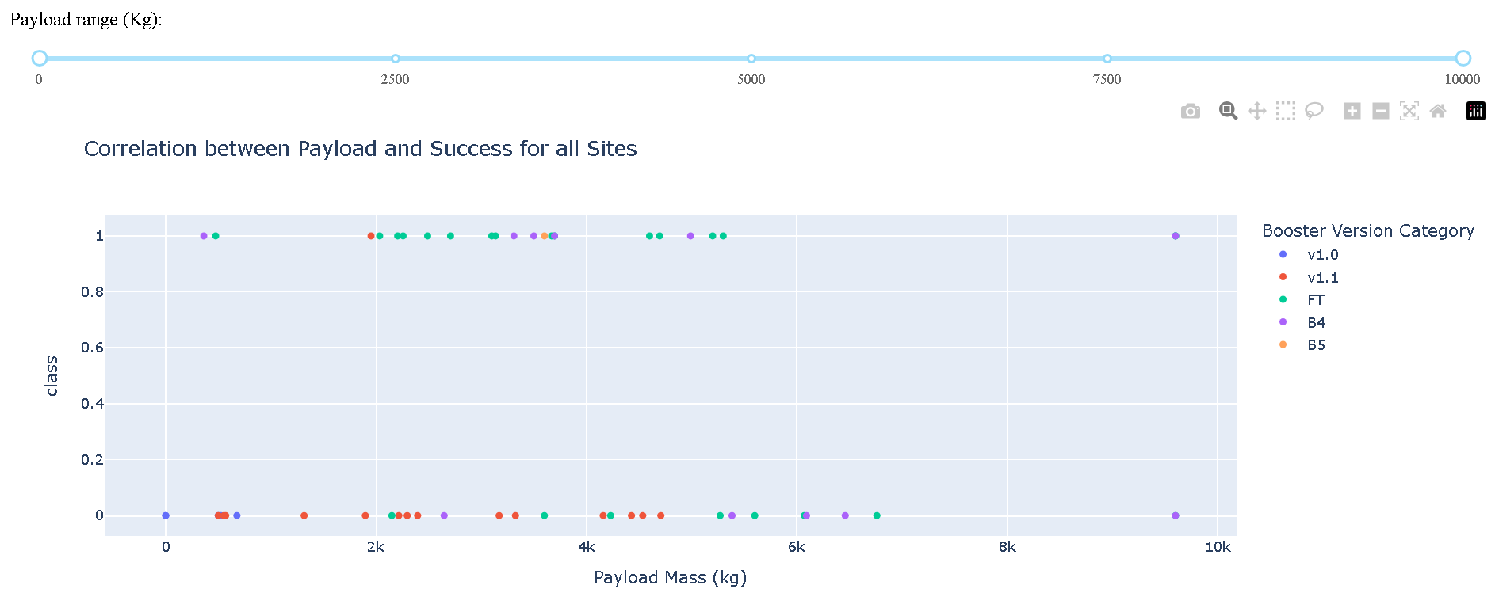
Results – Interactive: Slider & Scatter Plot

Slide 44

Section 5

Slide 45
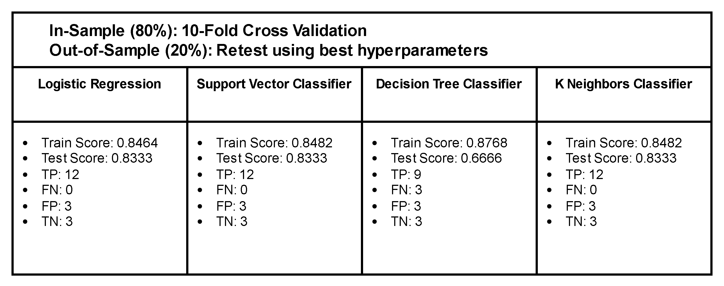
Results – Predictive Analysis

Slide 46
Conclusions
Launch Success: High success rates are linked to specific launch sites and optimal payload ranges (2000-5000 kg).
Orbit Types: Certain orbits like ES-L1 and GEO show higher successes
Predictive Analysis: 3 out of 4 machine learning models effectively predict SpaceX's first stage reuse, demonstrating valuable forecasting potential.
The insights gained from this analysis can help SpaceY optimize its launch strategies, focusing on more successful launch sites and payload configurations. By leveraging similar machine learning models, SpaceY could improve its predictive capabilities, thereby enhancing decision-making and operational efficiency.

Slide 47
Appendix
Decision Tree Classifier gives different scores when re-running the jupyter notebook.
Besides Decision Tree Classifier, every other models are equally suitable for landing success prediction with test precision of 0.8333

Slide 48


